Slide 1
Image Enhancement For Better Visualization
Guided By :
Dr. Bhogeswar Borah
Professor & HOD
Presented By:
Hari om jee (CSM20010)
Chinmay Chandra Das (CSM20039)

Slide 2
Digital Image :-
Digital Image is composed of a finite number of elements, each of which elements have a particular value at a particular location.
A Pixel is most widely used to denote the elements of a Digital Image
Digital image = a multidimensional array of numbers or vectors.

Slide 3
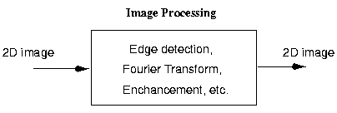
Image Processing:-
Manipulation of digital images by computer.
Image processing focuses on two major tasks
Improvement of pictorial information for human interpretation and high level processing.
Processing of image data for storage and transmission

Slide 4
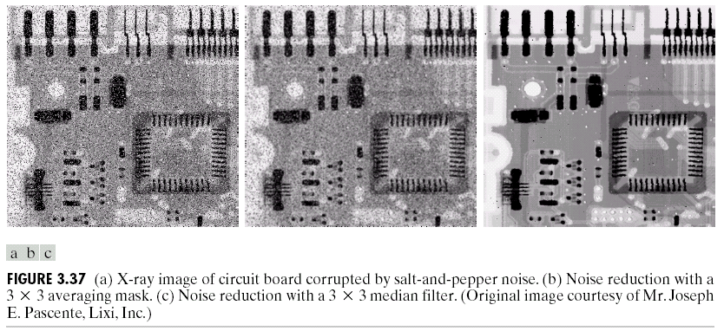
Image Enhancement:-
Improve quality, remove noise .

Slide 5
Source of noise:-
Acquisition
Capture images
Transmission
Sharing.

Slide 6
Image Enhancement Techniques:-
Spatial Domain
This techniques are perform to the image plane itself and they are based on direct manipulations of pixels in an image.
Frequency Domain
Frequency domain filters are different from spatial domain filters as it basically focuses on the frequency of the images.

Slide 7
For Enhance images
We Developed
PixelMod

Slide 8
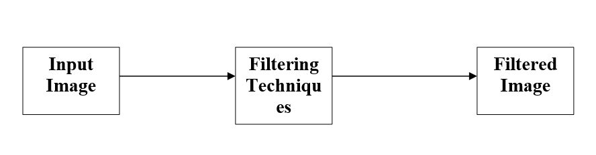
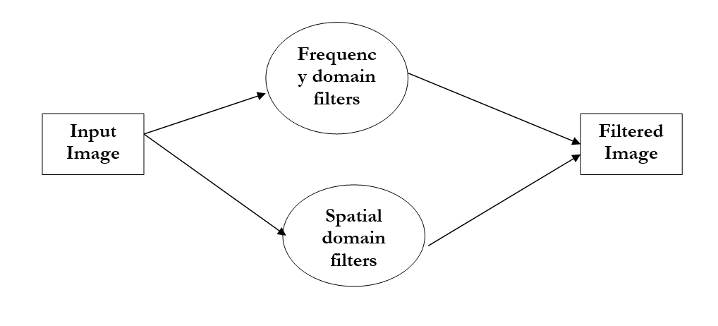
DFD:-
Context level diagram
First Level Diagram:

Slide 9
Spatial Domain:-
Process:
g(x,y)=T[f(x,y)]
Where g(x,y) = Output image
f(x,y) = Input Image
T = operation.
Divided into two category:
1. Point Processing
2. Filtering

Slide 10
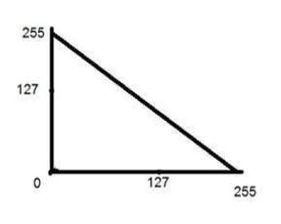
1. Point Processing:
It works on 1*1 window.
Operations:
Image Negative- Enhance white or gray details
Application – Medical images

Slide 11
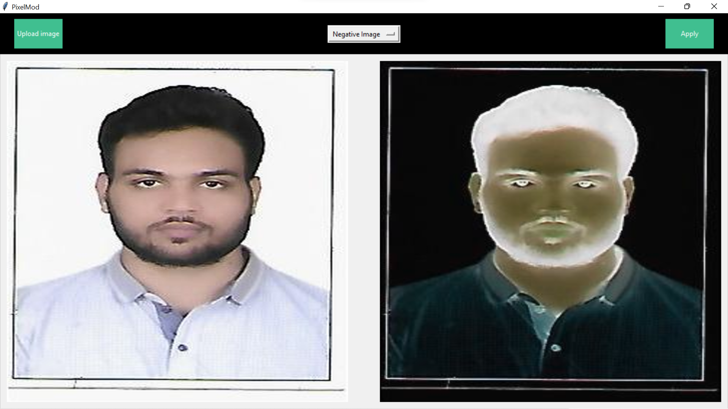

Slide 12
2.Log transformations:-
Compress the dynamic range of images with large variations in pixel values
Replacing all pixel value ,present in image with its logarithmic values.
It is used for image enhancement as it expends dark pixel of image as compared to higher pixel values.
We use this when dark pixel is more than bright pixels.
Where C= 255/(log1+max input pixel value)

Slide 13
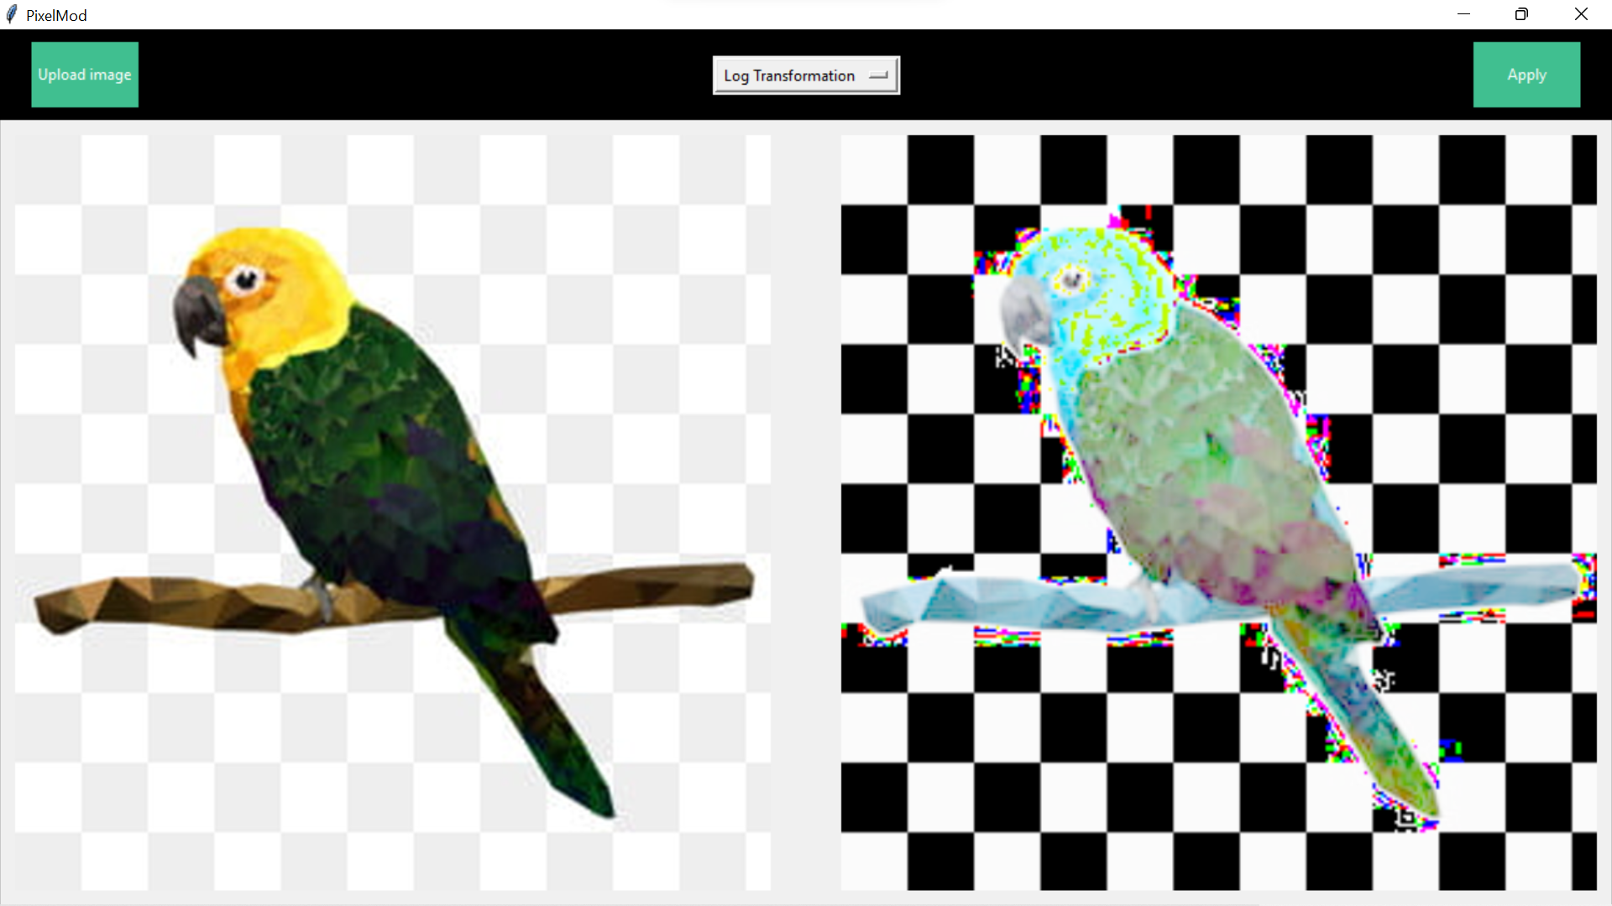

Slide 14
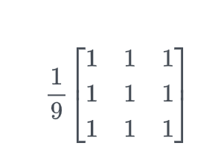
2. Spatial Filter:-
1.Box Filter-
It smooths the image by making each output pixel the average of the surrounding ones, removing details, noise and edges from images.

Slide 15
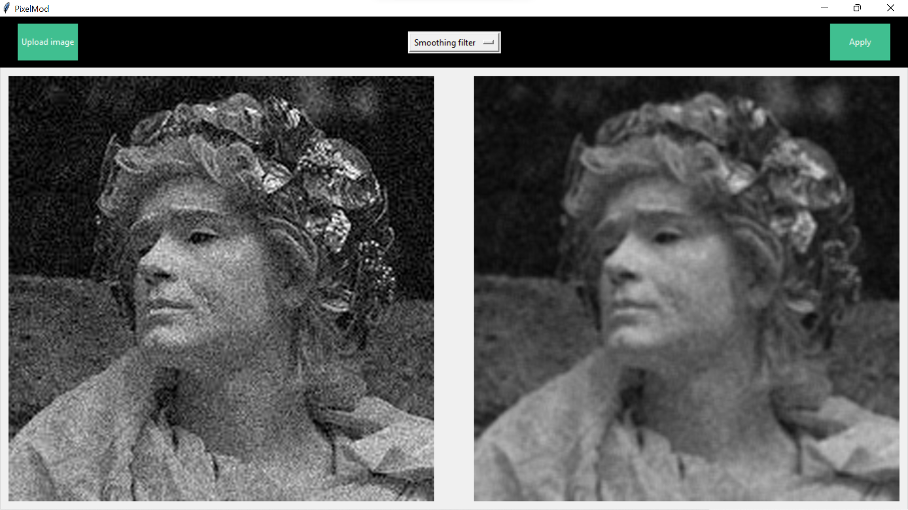

Slide 16
2.Averaging filtering:-
Normalized of Box filter.
It is method of 'smoothing' images by reducing the amount of intensity variation between neighboring pixels including itself.

Slide 17
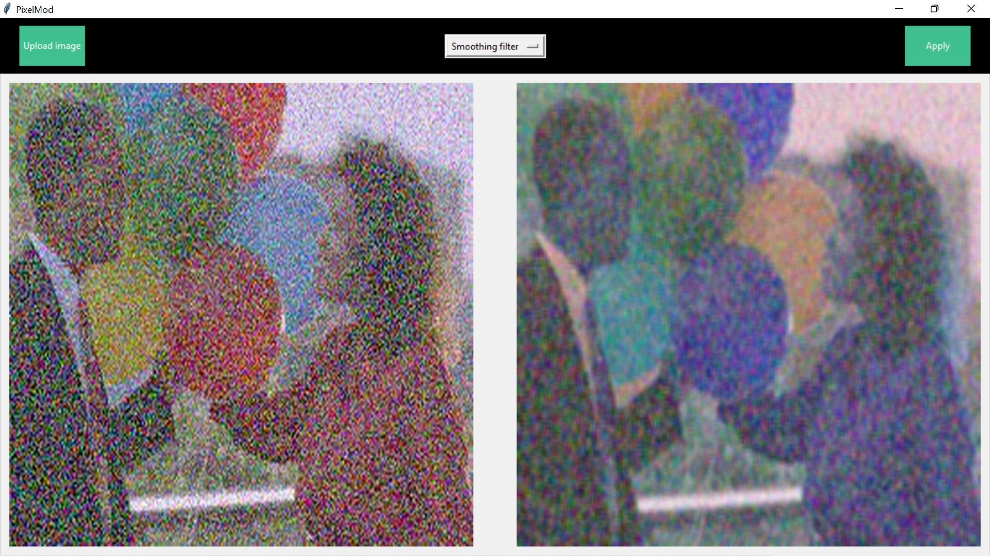

Slide 18
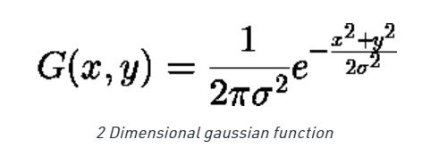
4.Gaussian Filter:-
It is used for reducing noise (high frequency components) and blurring regions of an image.
A Gaussian Filter could be considered as an approximation of the Gaussian Function.
Where σ is standard derivation
Effective than box filter.

Slide 19


Slide 20
Median Filter:-
It is used to eliminate salt and pepper noise.
Here the pixel value is replaced by the median value of the neighboring pixel.

Slide 21
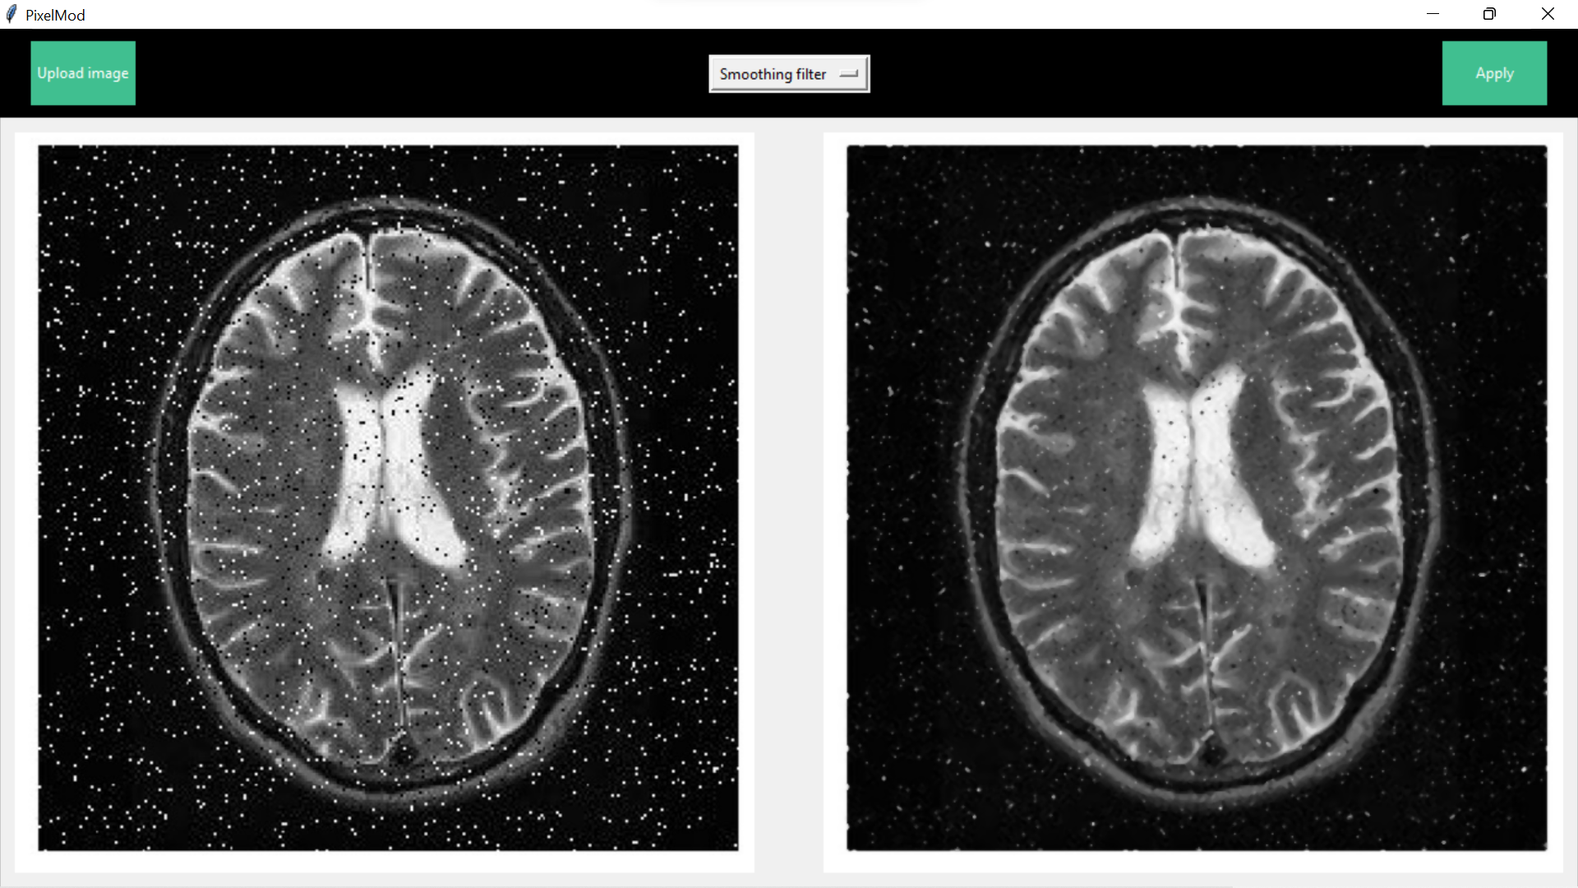

Slide 22
Denoising:
Image denoising is to remove noise from a noisy image, so as to restore the true image.

Slide 23
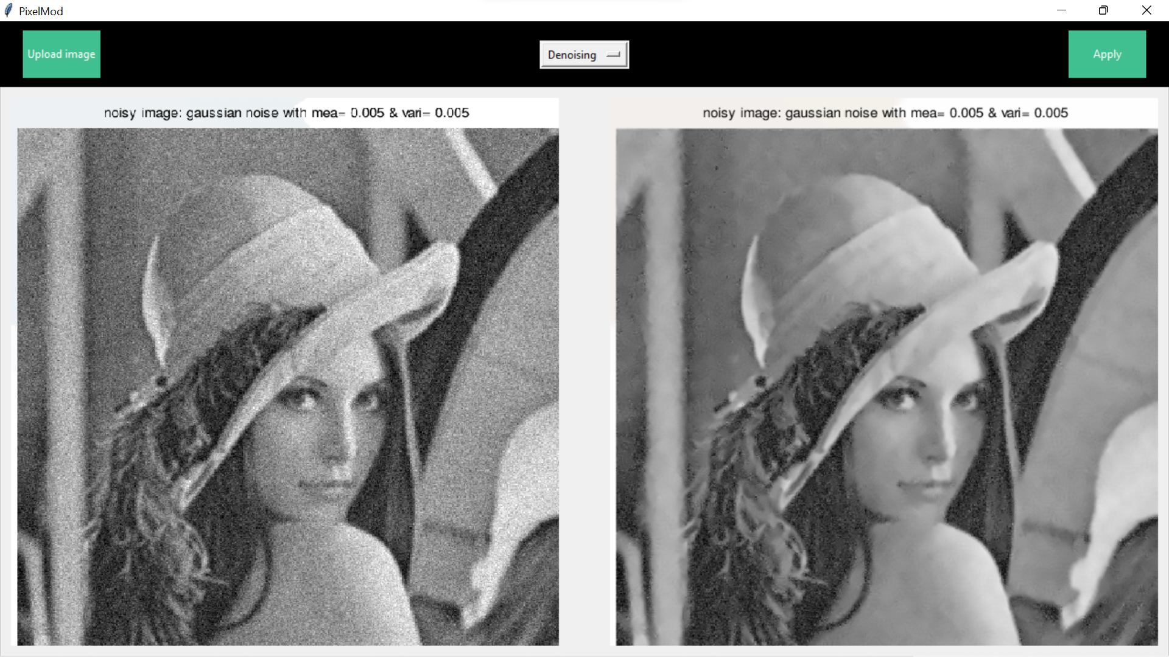

Slide 24
Canny Algorithm:-
It is useful for edge detection.
Canny edge detector have advanced algorithm derived from the Laplacian operator.
Application –
face recognition and fingerprint recognition
locate an object in satellite images

Slide 25
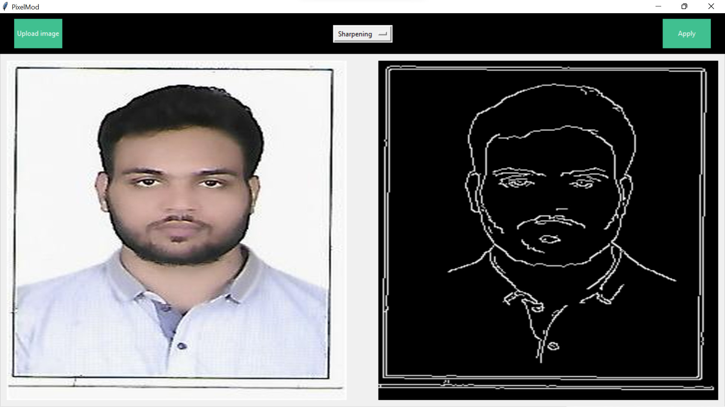

Slide 26
Sharpening:
Detect the noise and after that subtract the noise from input image.
Highlight the edges.

Slide 27
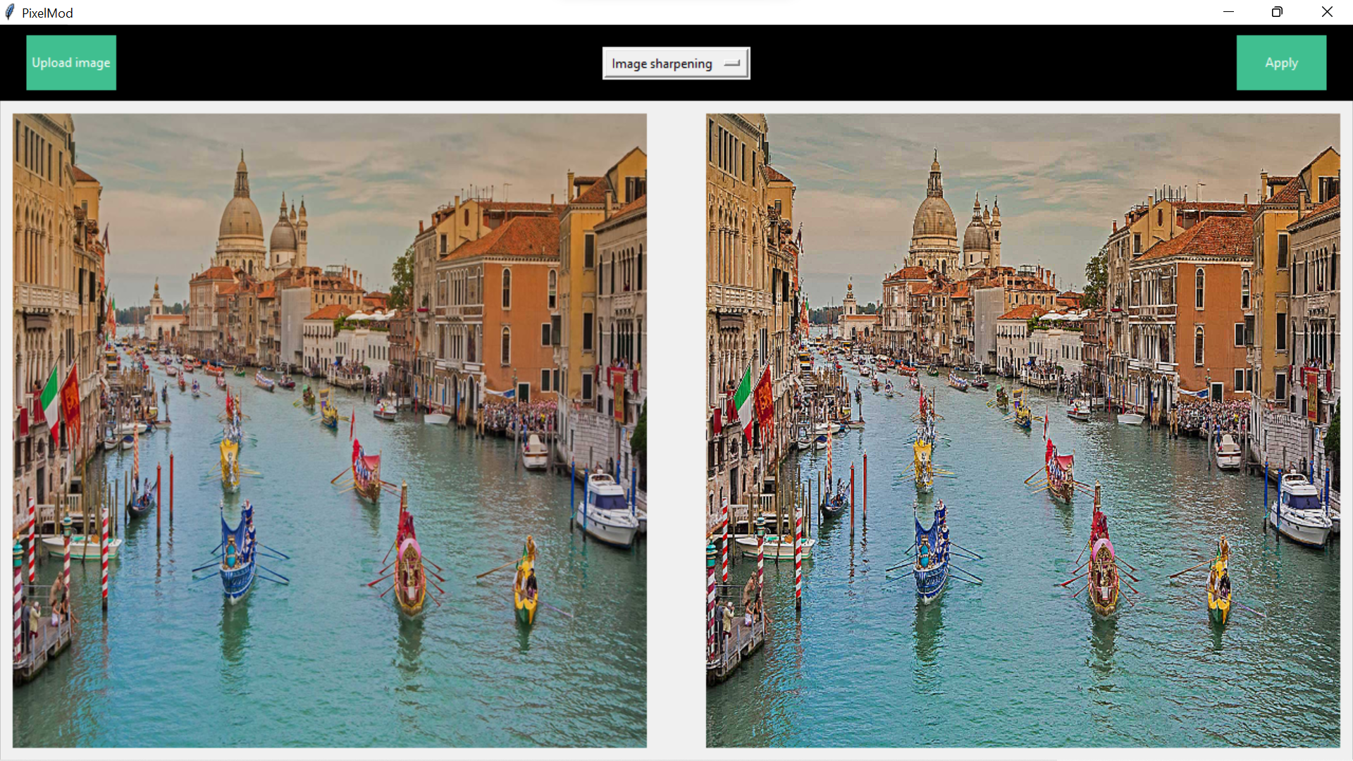

Slide 28
Conclusion:-
The image enhancements techniques play a significant position in digital image processing. It's shown in this study that the nonlinear image enhancement can be utilized to improve the quality of a blurred image by using the concept of the light source refinement. Image enhancement algorithms offer a wide variety of approaches for modifying images to achieve visually acceptable images. The choice of such techniques is a function of the specific task, image content, observer characteristics, and viewing conditions.

Slide 29
Thank you..

